Slide 1
Computer Mediated Activity 2021

Slide 2
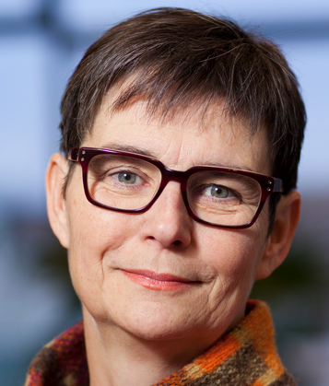
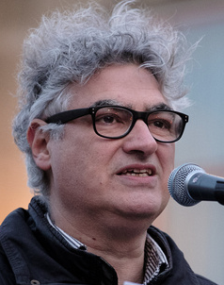
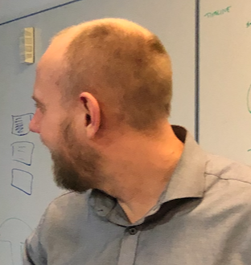
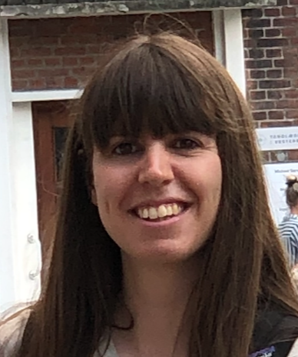
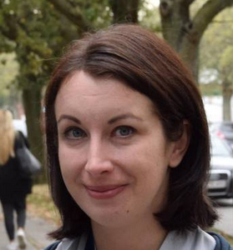
Who are we?
Susanne Bødker
Olav Bertelsen
Eve Hoggan
Henrik Korsgaard
Ida Larsen-Ledet
Research
Education
Collaboration
Talent

Slide 3
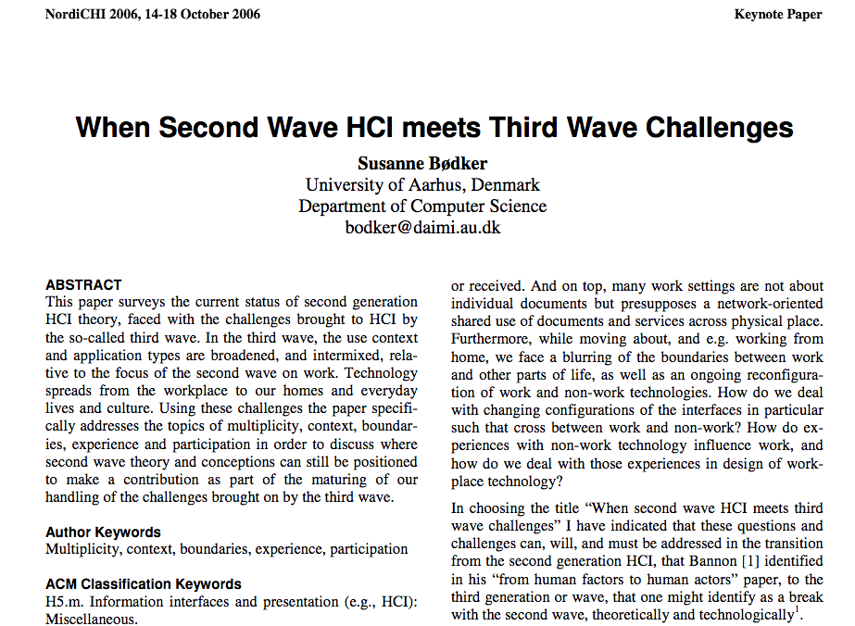
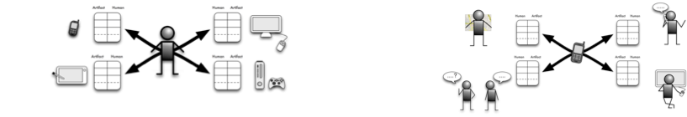
What do we do?
Activity theoretical HCI
Multi-modal interaction
Community technologies
Participatory Design
Computer Supported Cooperative Work

Slide 4
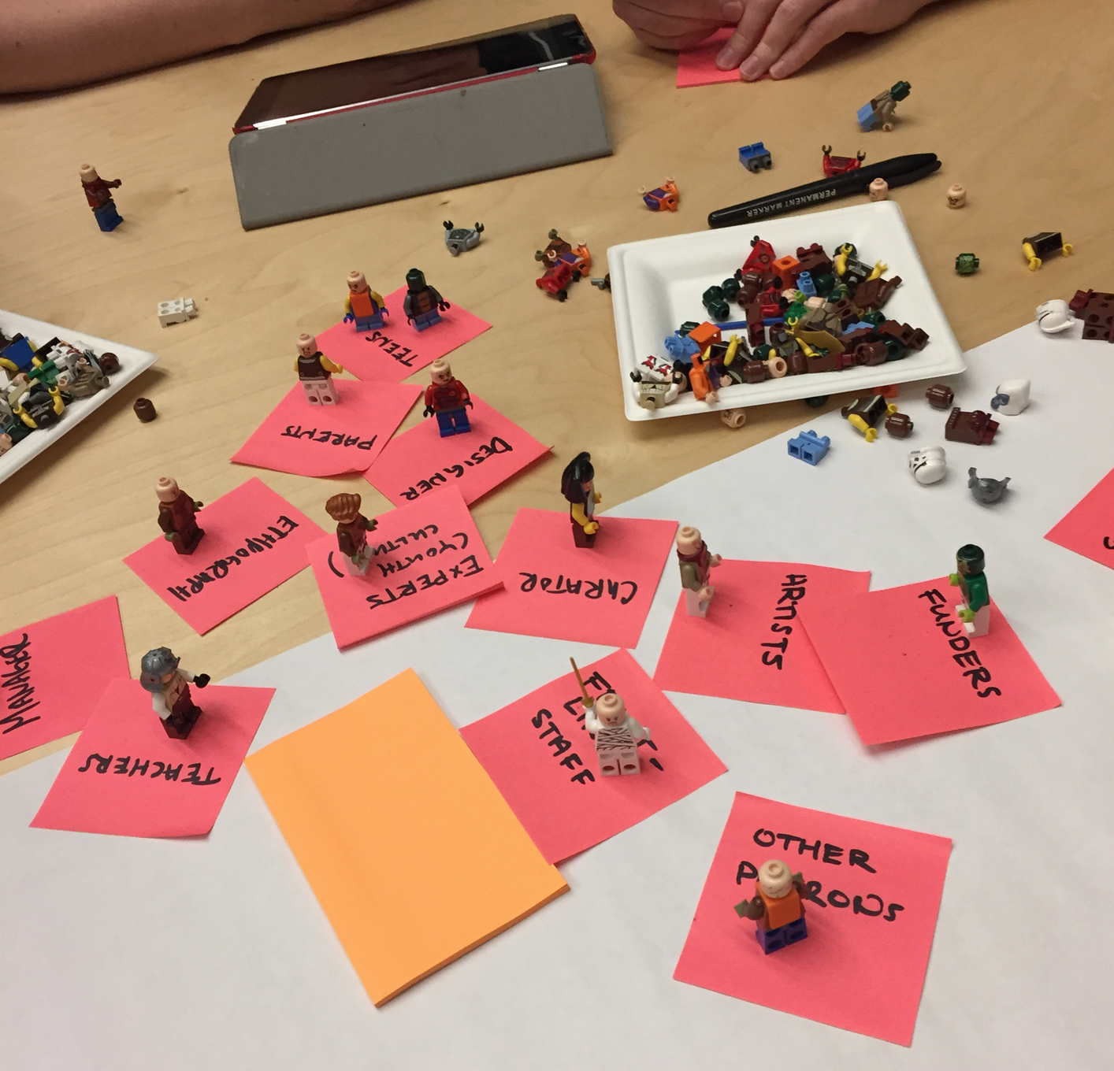
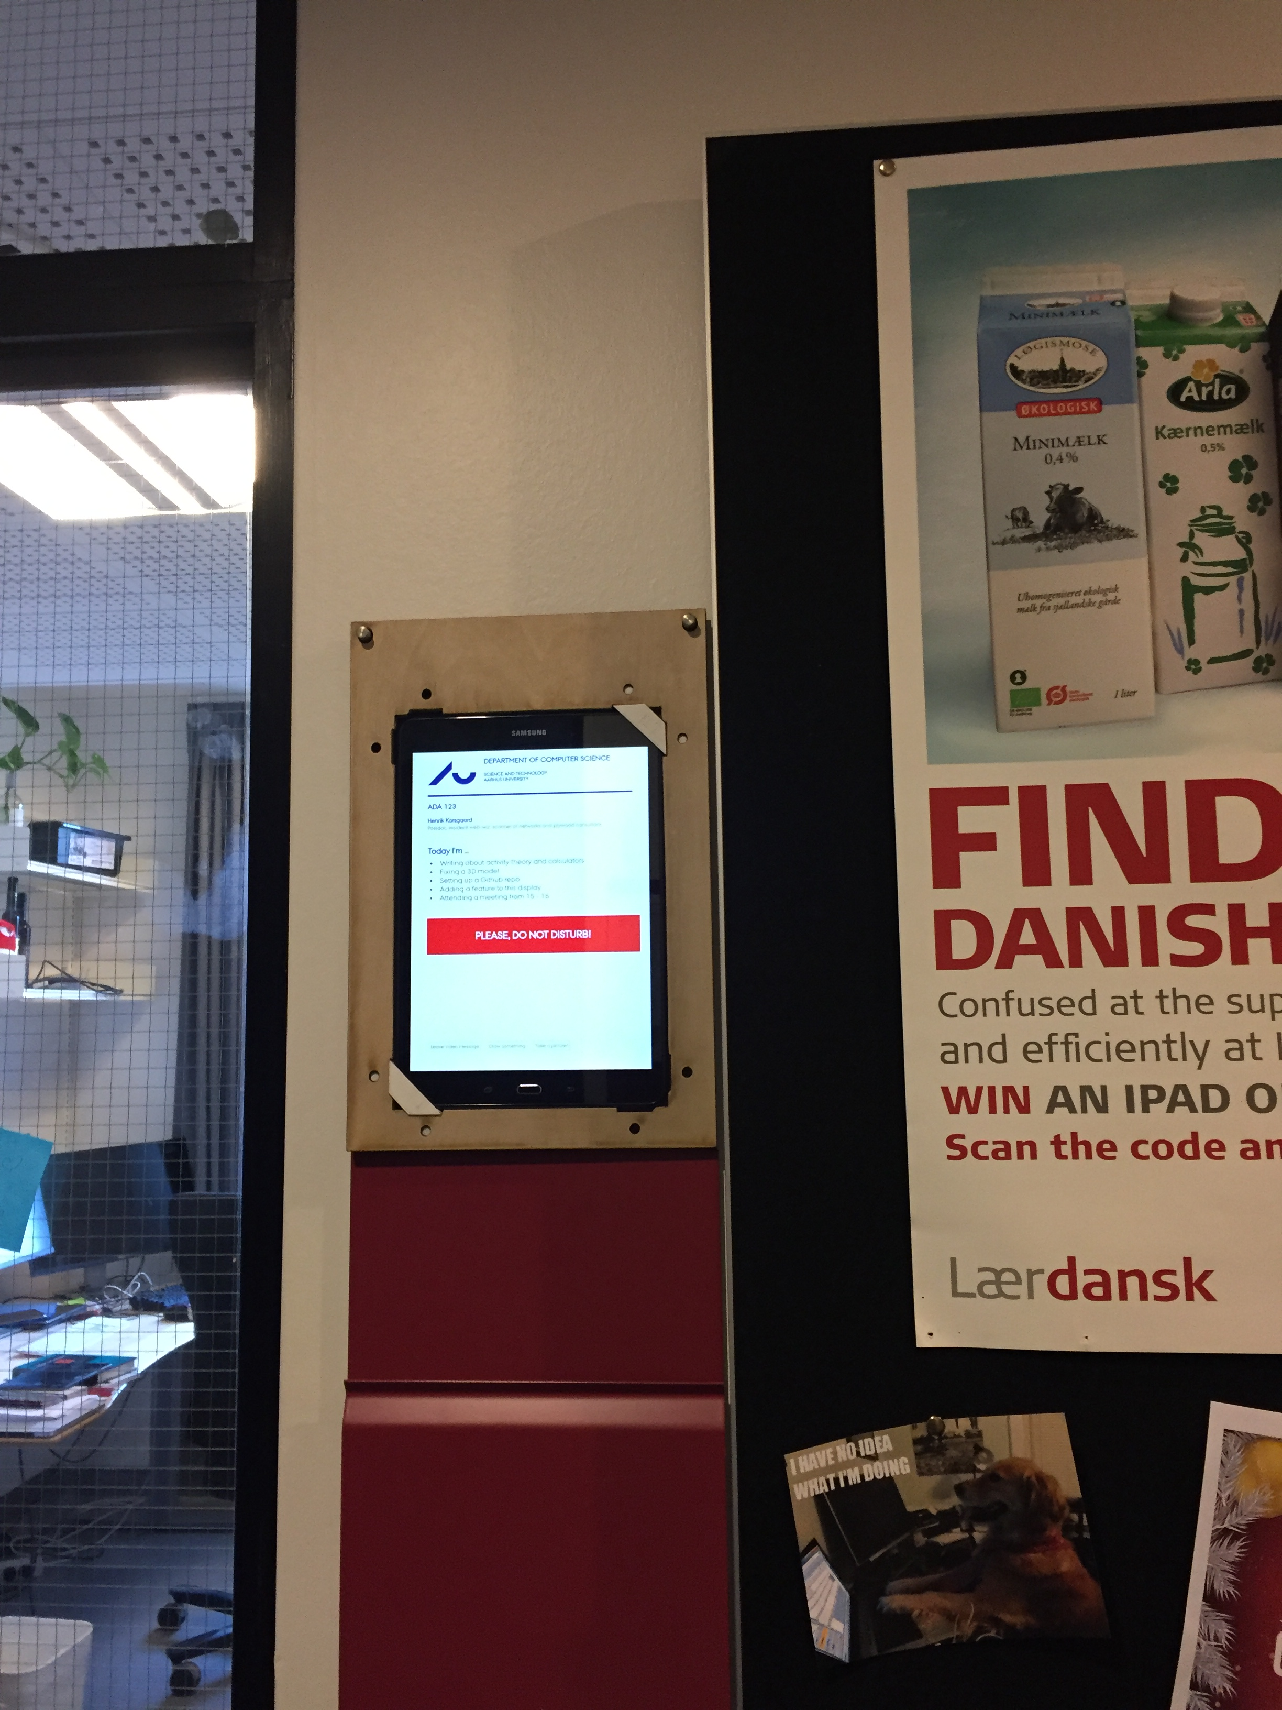
Mediation and Artifact ecologies
Activity theoretical HCI - Concepts, dynamics, methods of analyzing and designing for, building

Slide 5
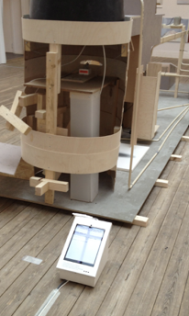
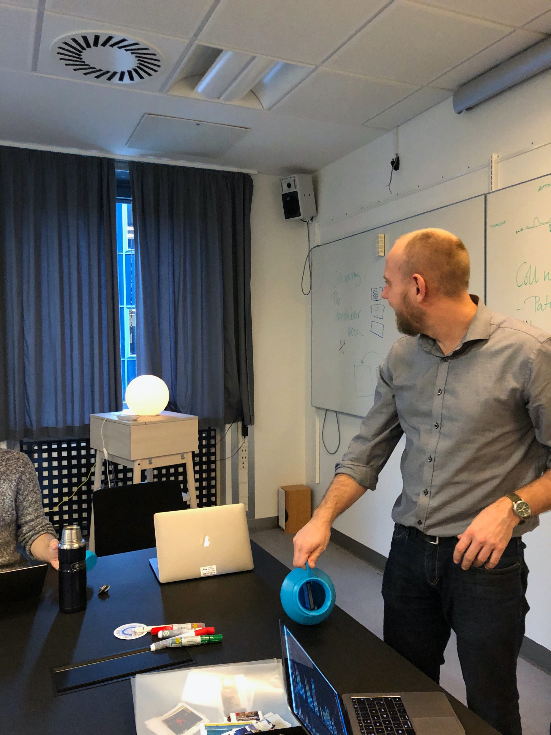
Communities and modalities

Slide 6
Projects
1. Online/physical community applying participatory design - Susanne Bødker
2. Newcomers versus experts in an online community - Susanne Bødker
3. Shared traces in collaborative virtually activities - Susanne Bødker
4. Walkthrough based interface assessment methods with context in mind - Olav Bertelsen
5. Interactive Tools for Open Data Platforms - Henrik Korgaard
6. Data Journalism – Asking Good Questions to Data? - Henrik. Korsgaard
7. I/O Ambient eInk Displays - Eve Hoggan, Henrik Korgaard
8. Wearable Physiological Sensors - Eve Hoggan
9. Multimodal We-Awareness in Remote Communication - Eve Hoggan
10. Magnetic Haptic Feedback - Eve Hoggan
11. 3D Printed Active Haptic Feedback - Eve Hoggan
12. Visualizing Collaboration - Ida Larsen-Ledet, Susanne Bødker
13. Online Activism - Ida Larsen-Ledet, Susanne Bødker

